Slide 1
CPS strategy WS 210929
Scandic hotel, Luleå
12.00 - 20.00

Slide 2
Meeting objective
The major topic is CPS focus and funding opportunities
Preparation from each of you:
Funding plan for your PhD students
CPS courses

Slide 3
Agenda
Start 8.00
Prognos P2 2021
Project proposal status, walk through of the excel sheet
Budget 2022
New research questions/topics
Github at LTU, Kåre
SysML course, Jan
Dissertations and Licentiate thesis
Division days Nov 8-9
End 20.00 dinner will be provided

Slide 4
CPS status
Staff
PhD students
Economy
Projects

Slide 5
Staff
Faculty
Jerker
Olov
Ulf
Jan
Fredrik - ML
Kåre - DCC
Shailesh ??
Cristina
PostDoc
Roghayeh

Slide 6
PhD students
Kim Albertsson, oct 2021: Fredrik
Jacob Nilsson, Dec 2021: Fredrik
Emanuel Palm, Sept 2021: Ulf
An Lam, Nov 2021: Jerker
Silia Maksuti, Oct 2021: Jerker
Saleha Javed: Marcus -> ML?
Karl Ektröm: Fredrik -> ML
Rickard Brännvall: Fredrik -> ML
Abdullah Aziz: Olov
Carl Borngrund: Ulf
Alex Chiquito: Ulf
Eric Chiquito: Ulf
Shai Fernandez: Ulf
Jaime Garcia: Jerker
Salman Javed: Jan vD
Mattias Nilsson: Fredrik
Aparajita: Jan vD
Sree: Olov

Slide 7
 | CPS
Ingående eget kapital 2021 | 6 003
Beräknat resultat 2021 | 2 540
Utgående eget kapital 2021 | 8 543
Beräknade kostnader 2021 | 31 709
EK i % av kostnadsomslutningen | 27 %
EK få max vara 20% av kostnadsomslutningen | 6 342
Beräknat överskott | 2 201
Riskerar att bli av med 50% av överstigande 20% | 1 101
Förbruka för att minimera risken att bli av med EK | 1 800
Planerade inköp, inlagda i prognos 1:
Datorer - kompetenta maskiner | 250
Konsulter - Videos ProcessIT | 500
GPU:er - Upphandling på G - Marcus L sköter det. Ev 2 milj | 700
Material | 500
 | 1 950
Economy
Balance sheet

Slide 8
2022 base line budget
 | Prognos 1 2021 | Prognos 2022
Anslag forskning | 9 956 | 7 647
Externa medel bidrag | 24 293 | 13 612
Summa S:a intäkter | 34 249 | 21 259
Lönekostnader inkl lkp | -16 220 | -14 735
Övr personalkostnader | -138 | -138
Kostnader för lokaler | -1 095 | -1 036
Utrustning | -700 | -200
Datorer | -854 | -553
Material | -750 | -300
Resor | -540 | -540
Övriga tjänster | -3 565 | -1 565
Övriga driftskostnader | -562 | -362
Avskrivningar | -311 | -311
Indirekta kostnader | -6 975 | -6 336
Transfereringar |  | 0
Summa S:a kostnader | -31 709 | -26 075
Resultat | 2 540 | -4 816

Slide 9
Projects
Arrowhead Tools - July 2022
DigiPrime - Dec 2023
Compact Sept 2022
KnowITFast Sept 2022 -> Dec 2022
ALDEE - Juni 2022
MetMaskin - Oct 2022
…

Slide 10
Funding applications
Submitted
Vinnova - India-Sweden smart city, Jan
In preparation
List from last strategy meeting

Slide 11
GitHub Education
Next, return to the your GitHub Education benefits page to upgrade organizations you utilize for teaching purposes, academic research, or for a student club you advise,
Learn more about GitHub Education's programs for teachers, like GitHub Campus Advisor training -- or request a GitHub Education Swag Bag filled with GitHub educational materials and motivators (including Octocat stickers) to share with your students:
https://education.github.com/teachers
When requesting materials be sure to tell us how many students you teach, the physical mailing address of your school (including zip/postal code), and your telephone number (including country code.)
Make sure you introduce yourself to the GitHub Education Community:
https://education.github.community
If you need assistance, consult our help articles here:
https://help.github.com/categories/teaching-and-learning-with-github-education
Give the gift of GitHub Education to your entire school:
https://education.github.com/partners/schools

Slide 12
Ideas
EISLAB Scrum team
Code and data artefacts as part of thesis

Slide 13
Funding opportunities - Jerker
TES - Transforming the Electricity Sector
Production automation, Supply and recycling of rare earth materials
Energimyndigheten - 10år MSEK200 to LTU
Deadline May 30
Crashed

Slide 14
Funding opportunities - Jerker
ONTOSteel
Interoperability in the steel sector
RFCS/HEU - 300k€ to LTU

Slide 15
ONTOSteel
FG Smart Factory
7 April 2021
Costanzo Pietrosanto
Valentina Colla
Marcus Neuer
Jerker Delsing
Michael Kohlgrueber

Slide 16
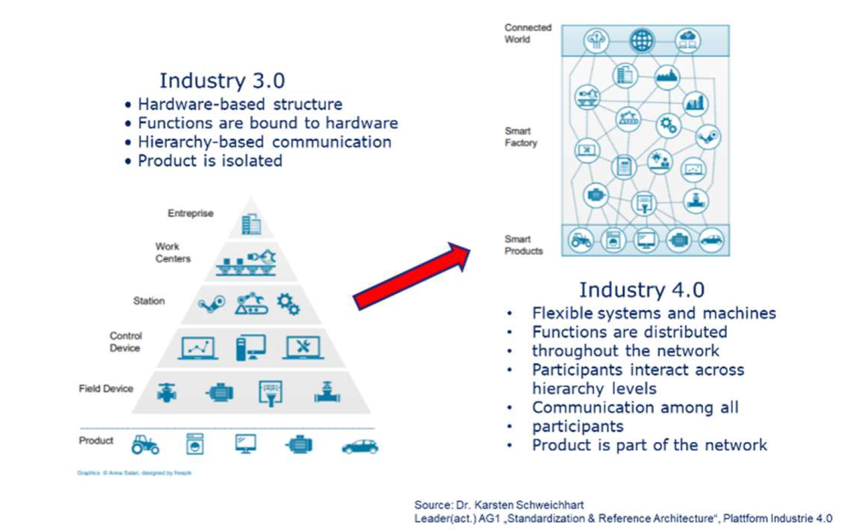
ONTOsteel Standardised approach for global digitisation and interoperability in the steel sector
Technological context
High speed transformation towards industry 4.0 and beyond
Uncountable integration of physical and software components along the value chain
Seamless flow of information – horizontally and vertically

Slide 17
ONTOsteel Standardised approach for global digitisation and interoperability in the steel sector
Interoperability initiatives in related sectors

Slide 18
ONTOsteel Standardised approach for global digitisation and interoperability in the steel sector
Ambition
Enabling interoperability of automation components and systems
Setting up guidelines, standard models, and tools to accelerate the
digital transformation of the steel sector
Expected benefits
Fundamental, basic work empowering the steel sector to develop cutting edge applications
Demonstrating seamless integration of information in steel production value chain

Slide 19
ONTOsteel Standardised approach for global digitisation and interoperability in the steel sector
2-Phase approach
Phase 1 ESTEP TASK: 6-9 months
Preparation of detailed project proposal including selection of flagship examples/ case studies
In-kind contribution of involved organisations, analysis of potential synergies with running project, (e.g. ESSA, SPIRE-SAIS)
Phase 2 FOUNDED PROJECT (RFCS/HEU in the CSP perimeter: 3-4 years
Execution of the project if selected for funding (RFCS, Horizon Europe)
Decision SG54-16 March2021

Slide 20
ONTOsteel Standardised approach for global digitisation and interoperability in the steel sector
Next step
Forming of Phase 1 working groups
Literature analysis
Project analysis
Requirements
Flagship preparation
Proposal writing
Consortia

Slide 21
Challenge
1200 GWh
1000 GWh
OEM’s:
Securing long term Contracts in Asia
Failing to secure supply near European Plants
Largest value in Packaging
35-45% of total cost
Supply Chain Risks
1% in Europe
(97% in China, Japan, & Korea)
Northvolt
LG Chem
Samsung
CATL
…
Import
/-/
Manufacturing Capacity in Europe
20 % annual growth
/…/
45-95
Giga Factories
170 GWh
30 GWh
Current
Confirmed
Projected
Demand
2040
EVM Gap

Slide 22
Eco-System
Access to Raw Materials
Electricity Producer
Cell Manufacturing
Processing
User of
Solution
Recycler of Solution
Recycled materials
Packaging

Slide 23

Competence Center
Securing Access to Raw Material
Processing of Primary, Secondary and Recycled (Tertiary) Materials
Flexible and Autonomous Manufacturing

Slide 24
Funding opportunities - Jerker
PVN - Production Value Network Interoperability
KDT - 60M€ - LTU 2.5€
Lead by ProcessIT
Deadline early 2022

Slide 25
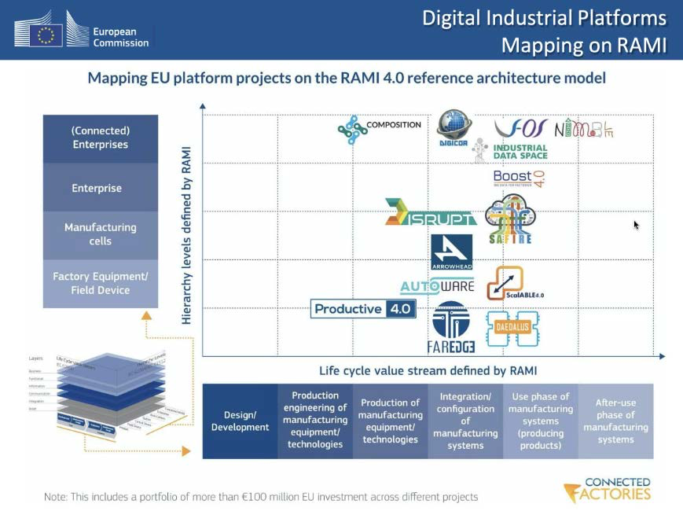
Enterprise Standard

Slide 26
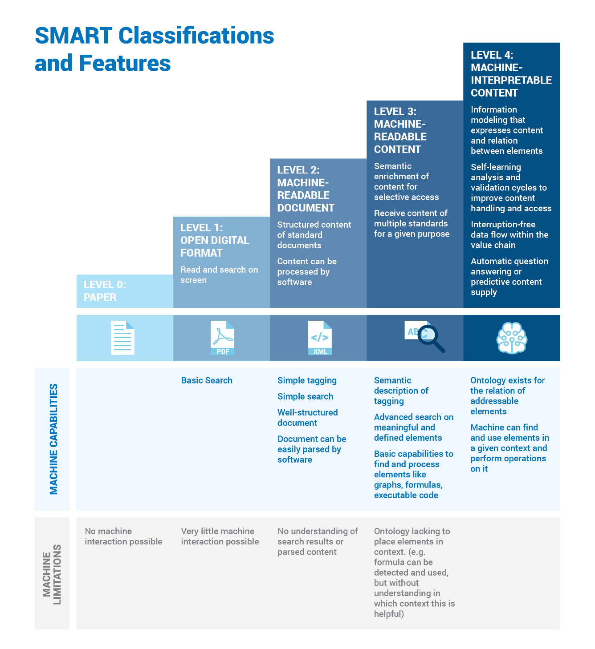
Connected Enterprise
Production Value Networks:
Process Ind.
Material Flow (eg. Plastics)
Man. Eq. & Systems
Business
Ecosystem
Business
Ecosystem
Man. Sys.
EPC
OEM
Electronic Components
and Systems
Business
Ecosystem
Business
Ecosystem
Electronic Components & Systems
ECS
EPC: Engineering, Procurement & Construction
Man.Sys: Industrial Manufacturing Equipment, Solutions and Systems
OEM: Original Equipment Manufacturer
ECS: Suppliers of electronic Components and Systems

Slide 27
Funding opportunities - Jerker
PI2 - Productive Inteligence 2
KDT - 60M€ - LTU 1M€
Lead by Infineon
LTU CPS lead Jerker
Deadline early 2022
Swedish partners
SEB
Husqvarna
Network integration platform company
LTU CPS, Vinit

Slide 28
Ericsson - Jerker
Early stage
If signed as an Ericsson strategic partner numerous opportunities will come
Following some of our ongoing work with 5G Infrastruture Associatio, this is a kind reminder of the ‘Smart Networks and Services Info Session’ organised by the 5G IA for tomorrow, 11th June, 14:30 - 17:30 CEST during EuCNC & 6G Summit.
The agenda is available at: https://www.eucnc.eu/smart-networks-and-services/
For your convenience, please find below some important information to be sure that you are correctly registered to the ‘main EuCNC & 6G Summit conference’ and to the ‘Smart Networks and Services Info Session’:
To register to the ‘main EuCNC & 6G Summit conference’, you have to tick one of the two following boxes in the registration form (https://www.eucnc.eu/registration/):

Slide 29
Jotne
cHORIZON-CL5-2021-D5-01-06: Next generation digital aircraft transformation in design, manufacturing, integration and maintenance
HORIZON-CL5-2022-D5-01-13: Digital aviation technologies for new aviation business models, services, emerging global threats and industrial competitiveness
HORIZON-CL5-2021-D3-01-14: Interoperability community
HORIZON-CL5-2022-D3-02-01: Digital solutions for defining synergies in international renewable energy value chains
HORIZON-CL5-2021-D4-01-02: Industrialisation of deep renovation workflows for energy-efficient buildings
HORIZON-CL5-2021-D4-01-03: Advanced data-driven monitoring of building stock energy performance
HORIZON-CL5-2022-D4-02-05: More sustainable buildings with reduced embodied energy / carbon, high life-cycle performance and reduced life-cycle costs (Built4People)
HORIZON-CL5-2021-D5-01-01: Nextgen vehicles: Innovative zero emission BEV architectures for regional medium freight haulage (2ZERO)
HORIZON-CL5-2021-D5-01-13: Digital Twin models to enable green ship operations (ZEWT Partnership)
HORIZON-CL5-2022-D5-01-08: Modular multi-powertrain zero-emission systems for HDV (BEV and FCEV) for efficient and economic operation (2ZERO)
HORIZON-CL5-2022-D6-01-05: Artificial Intelligence (AI): Explainable and trustworthy concepts, techniques and models for CCAM (CCAM Partnership)

Slide 30
LTU strategic area
Electrification
Digitalisation
Resilience and sovereignty
Human computer cooperation and organisation

Slide 31
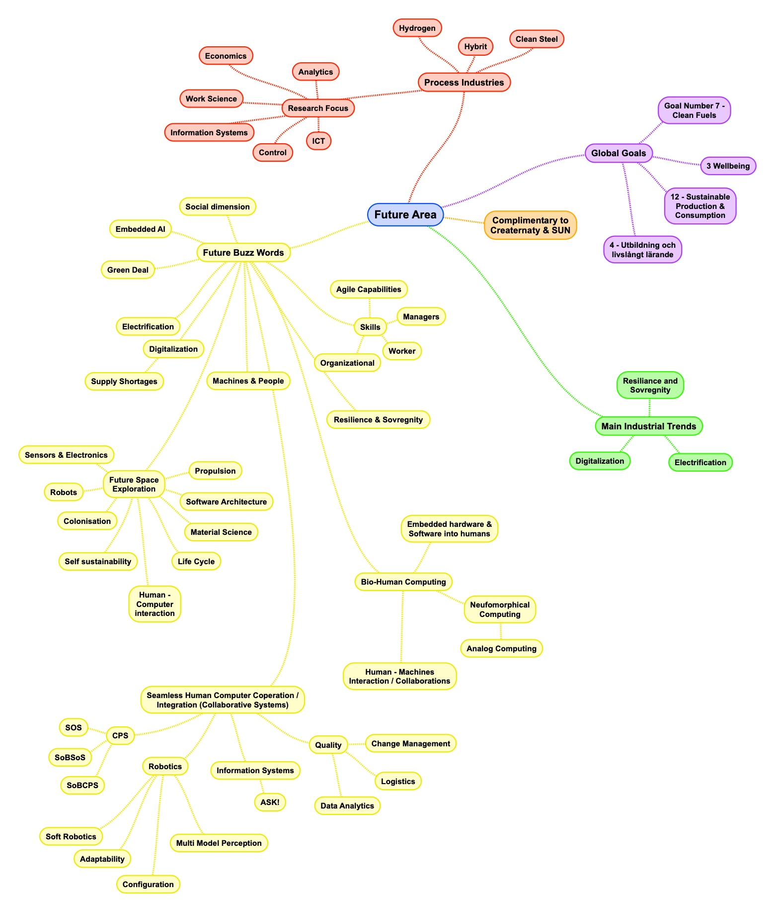
LTU strategic area

Slide 32
Background
Ericsson one of the funders of CDT since 25 years ago
Long tradition to work together Ericsson - LTU
Yearly meetings exchanging research ideas
LTU ambition to get a long term collaboration agreement!
Ericsson have 5 unique university collaboration agreements, LTU aim at becoming the 6th!

Slide 33
Process
Work shop #1 (April 14): Goal is to find 2-3 research areas/ideas of common interest to further investigate. Participants is therefor a small group (NOT excluding others)
Work shop #2 (TBD): Date to be set in May. One person from LTU and one person from Eri will lead the parallell groups that will further work on the selected ideas from #1. At the end of the day, jointly report back to the group. At #2 many new specialists/experts on the selected topics will we brought into work.

Slide 34
Goals, April 14
Short term
2-3 research ideas/areas to jointly work further on and set the process for win-win collaboration, the strategy for the next level
Long term
Research Collaboration agreement LTU-Ericsson!

Slide 35
Proposal for bilateral collaboration between Ericsson and LTU
Three research pillars
20210519, Michael Nilsson,Centre for Distance-spanning Technology at Luleå University of Technology

Slide 36
Integrating Connectivity
Proposal for bilateral collaboration between Ericsson and LTU
Connected and programmable world
Ubiquitous
connectivity
Trustworthy connectivity
AI-assisted autonomous system interoperation
Sustainable
energy-efficient
connectivity
5

Slide 37



Three pillars
Ericsson-LTU technology research 2030
A.
Ubiquitous connectivity
B.
Federated
telecom
platform
C.
Industry
4.0

Slide 38
Each pillar defines
General
Objective, Approach, LTU expertise & background
Specific research topics
Where each topic relates to market targets
Joint activities, e.g.,
Project proposals, Mobility, Courses
Contributions to Ericsson’s ’Technology Journeys’ and ’Stepping Stones’
Stepping stones indicated where possible

Slide 39
Topic to Market principle
Market targets
Market targets
Market targets
Market targets
TRL
……
Topic 1
Topic N
Topic 3
Topic 2
Time

Slide 40
Pillar A: ubiquitous connectivity
Contributes to technology journeys:
‘Limitless connectivity’
‘Connected Sustainable world’

Slide 41
Pillar 1: Ubiquitous connectivity
Capacity, coverage & rural infrastructure optimization
New dynamic & flexible network architectures
Access to new rural and low-ARPU markets
New products for local rural networks
New tools for market analysis and regulatory models
TRL
3. MIMO/IRS for coverage extension & localization
1. Energy-constrained networks
4. Full LEO integration
2. Drone-enabled coverage
5. Inequality-measures and regulation
Time

Slide 42
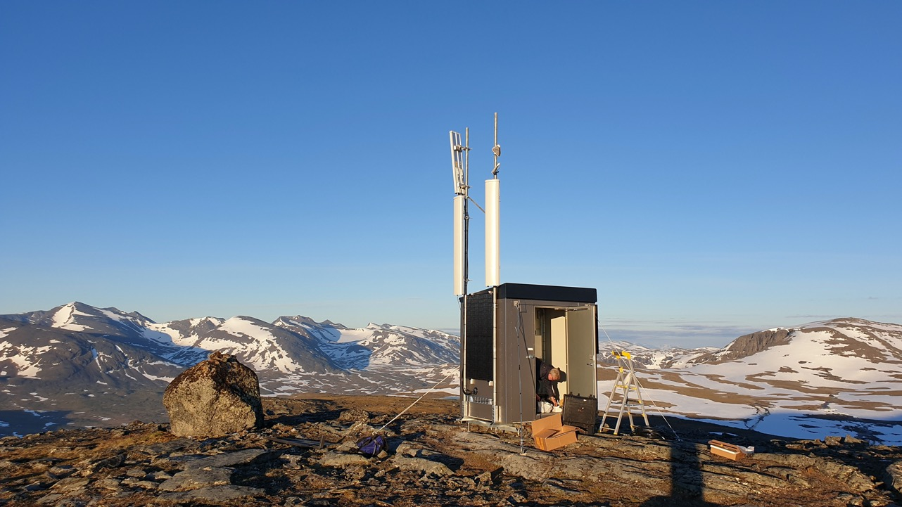
1. Energy-constrained networks
Objective:
reduce cost (capital and operational)
allow for massive rural network deployment
Approach:
Understand potential and capacity/coverage limits of energy-harvesting networks
New fully integrated energy- & communication-models
consequences for new network architectures and optimized radio protocols
LTU expertise & background:
Long-standing expertise in signal processing, network modelling
PHY-layer, lean protocols, energy models
Broad portfolio of rural coverage projects since 2015
Professor Jaap van de Beek
ICT for inclusion
zero-energy & -cost
nodes
Resource-efficient
ICT

Slide 43
2. Drone-enabled 5G/6G coverage
Extreme
performance
Network
adaptability
Objective:
Improving coverage and reliability in challenged, dynamic scenarions with drone-aided networks
Approach:
Autonomous swarm of UAVs for enabling connectivity of massive ground nodes in bounded regions operating in a dynamic environment.
Network performance studies in serving many drones simultaneously over a wide area (mixed ground aerial traffic scenarios)
Multi-hop relaying-based swarm of autonomous UAVs. Study interference, latency, distruption of UAV based wireless networks
Autonomous optimal positioning of UAVs to bridge communication between multiple static nodes. Connecting disjointed group of ground nodes.
Off-loading computational-intense processes from onboard instruments to the 5G Edge.
LTU expertise & background:
Decades-long experience with drones, robotics, and artificial intelligence, strong interest in experimental R&D
The Robotics Lab has an indoors 5G installation and we are part of the outdoor 5G installation@LTU
Professor George Nikolakopoulos
Flexible spectrum
usage

Slide 44
3. MIMO/IRS for coverage extension & localization
Objective:
Low-cost new coverage extension protocols. Understand potential for various spectrum bands
New IRS-based localization of wide-area UEs by network operators
Approach:
Exploit potential of distributed Intelligent Reflective Surfaces (IRSs), new models and algorithms, deployment analyses
Understand role/imprtance of IRS-placement on performance
LTU expertise & background:
Decades-long experience with multi-antenna signal processing
Professor Jaap van de Beek, Senior Lecturer Rickard Nilsson
Distributed
massive MIMO
Extreme
performance

Slide 45
4. LEO integration, backhauling
Objective:
Steps towards full integration of space- and terrestrial networks
Approach:
Broadband communication/roaming/multi-user technology demonstration
Demonstration of inter-satellite communications and autonomous space segment-ground segment interactions
Optimization of distributed, federated and fractionated mission concepts for different applications and its utilization
Broadband communications from LEO to HEO and beyond
LTU expertise & background:
Deep roots in the space community, in experimental design and in system integration
Professor Rene Laufer
Network
adaptability
Extreme
performance
Ultra-deep
coverage solutions

Slide 46
5. Coverage inequality, indexes, and regulation
Objective:
Effective, relevant new tools/measures for evaluations of societal KPIs, network deployment, policies, rural business models, and regulations.
Approach:
Develop and analyse new comparative units and measures.
Data-driven, geographic, nation-wide and regional network analyses and evaluationasures; c
Correlation with societal rural indicators
LTU expertise & background:
Portfolio of rural overage projects since 2015
Extensive network of societal stakeholders, regions, regulators
Unique bridge between radio expertise and societal impact
Professor Jaap van de Beek
ICT for inclusion
Ultra-deep
coverage solutions
Data sources: PTS, SCB, Lantmäteriet

Slide 47
Pillar B: federated telecom platforms
Contributes to technology journeys:
‘Cognitive network’
‘Network compute fabric’

Slide 48
Pillar 2: Federated telecom platforms
Self adapting services
Multi stakeholder edge services
Neuromorphic intelligence
TRL
1. Federated edge services​
3. Neuromorphic computing for real-time edge2core​
2. Federated Learning and Explainable AI for Cognitive Networks ​
Time

Slide 49
1. Federated edge services​
Objective:
Edge services discovery and peer interactions based on policies and dynamic shared contexts
Approach:
Machine intelligence for automatic context computation and dynamic discovery. Service pull to support contexts. Agreements with mobile devices and between mobile operators for seamless service availability
LTU expertise & background:
>20 years of experience from distributed​ and decentralized internet systems​. Several years of experience with service​ orchestration & discovery and ML
Prof Olov Schelen, Prof Fredrik Sandin
Seamless task​
mobility​
Autonomous​
system operation​
Cognitive​
network​

Slide 50
2. Federated Learning and Explainable AI for Cognitive Networks ​
Objective:
Intelligent computational resource allocation for cognitive networks with an integrated explainable AI framework
Approach:
Federated learning with a Belief Rule-Based Expert Systems (BRBES) and an Explainable AI framework will be developed and analyzed. This will ensure the balance between accuracy and explainability, necessary to effectively allocate computational resources within cognitive networks
LTU expertise & background:
~10 years of experience of BRBES and AI research​. Several years of experience in developing ​a plethora of methods forming a framework of ​evolutionary BRBES
​Prof Karl Andersson, Prof Olov Schelén
Distributed​
intelligence​
Explainable &​
trustworhy AI​
Cognitive​
network​

Slide 51
3. Neuromorphic computing for real-time edge2core​
Objective:
Low-power and –latency inference from edge to core in selected data-intensive applications (5G, UAVs, internet of senses, …)​
Approach:
declarative programming concepts and domain-specific neural network architectures and training protocols for dynamic neuromorphic processors​
LTU expertise & background:
Four years of hands-on experience​ of dynamic neuromorphic processors​. Several years of experience with​ simulation models and tools
​Prof Fredrik Sandin, Prof Olov Schelén
Real-time cloud stack and​
integrated connectivity & edge
Distributed​
intelligence​
Future computing​
paradigms​
Network​
compute fabric​

Slide 52
Pillar C: industry 4.0
Contributes to technology journeys:
‘Connected intelligent machines’
‘Digitalised and programmable physical world’
‘Trustworthy systems’

Slide 53
Pillar 3: Industry 4.0
Interoperability service
Cognitive Industry 4.0
Industry 4.0 network platform
Energy efficient edge
Autonomous value network operation
TRL
2. Self-organising SoS
1. Network platform for the programmable world
3. Energy efficient SoS
4. Interoperability
5. Ubiquitous fully autonomous SoS
Time

Slide 54
1. Network platform for the programmable world
Objective:
Dynamic network re-configuration
Runtime network deployment/re-configuration
Addressing security, scalability, realtime etc. around microsystem SoS
Approach:
Secure and self contained local clouds adaptation to 6G
LTU expertise & background:
Pioneering local cloud architecture and concepts for secure and mission critical solutions. A basic part of the Eclipse Arrowhead framework
Professor Jerker Delsing
Enhanced network platform features & services
Digital infrastructure for the programmable world

Slide 55
1. Network platform for the programmable world
Objective:
Enabling modularity and autonomy for the factory floor reconfigurability by novel programming approach based on portable software components
Approach
Adoption and further enhancement of the Universal Automation concepts based on the combination of leading international standards and AI
LTU expertise & background
More than 20 years experience of participating in the international research on novel software architectures for industrial automation
Professor Valeriy Vyatkin, Dr Sandeep Patil, Dr Chen-Wei Yang
Network as mediator for intelligent machines
Digital infrastructure for the programmable world
Connected intelligent machines

Slide 56
2. AI for autonomous self-integrating SoS
Objective:
Dynamic data interoperability and policy-driven utility optimisation concept for scalable self-integrating SoS
Approach:
policy- and knowledge-driven neural M2M message translation in SoS for system utility optimisation (cooperation)
LTU expertise & background:
Extensive experience of NLP and neural/cognitive message transcoding
Professor Marcus Liwicki, Professor Fredrik Sanding
Self-organising SoS
Collectively leraning and reasoning machines
Ubiquitous fully autonomous SoS

Slide 57
2. Service Matchmaking for Authorised Systems
Objective:
Dynamic matching of services between providers and consumers at run time
Traceable and responsible pre-configuration for secured deployment
Low maintenance authorization management based on policies and attributes
Approach:
Secure and self contained local clouds having systems and services with descriptions or metadata for both orchestration and authorization
LTU expertise & background:
Automotive, manufacturing and smart grid application developments based on the Eclipse Arrowhead framework
Associate professor Jan van Deventer
Self-organising SoS
Colaborative digital twins

Slide 58
Distributed life-long edge intelligence
3. Energy efficiency AI at the edge
Objective:
Bring AI functionality to low-end devices and enable online network assisted distributed learning for intelligent cities and industries.
Approach:
Novel methods for learning algorithms’ development for novel AI-tailored computer architectures (neuromorphic, specialised, embedded, hybrid). Network assisted intelligence. Novel energy-efficient AI algorithms.
Supervised, unsupervised, reinforcement learning for edge devices. Real time learning. One-shot learning. Continuous learning. Contextual learning.
LTU expertise and background:
Strong background in development of approximate computing algorithms tailored for future memristive memories and spiking microprocessors (semantic pointers, vector symbolic representations, computing with randomness).
Professor Evgeny Osipov
Programable things and materials

Slide 59
3. Programming neuromorphic substrates in SoS
Objective:
Autonomous configuration, optimisation and monitoring of dynamic neuromorphic perception systems (adaptive substrates)
Approach:
Abstraction via declarative programming and three-factor learning rules enabling configuration and optimisation via SoS-level AI
LTU expertise and background:
Extensive experience​ of dynamic neuromorphic processors
Professor Fredrik Sandin
Programable things and materials
Digital infrastructure for the programmable world

Slide 60
4. Interoperability
Objective:
SoS interoperability enables instant and seamless understanding of information exchanged within and between networked and distributed systems.
Approach:
ML and autonomous code generation approach based on data, metadata and ontologies
LTU expertise & background:
Autonomous M2M interoperability research since 2013
Professor Jerker Delsing, Professor Fredrik Sandin
Interoperability

Slide 61
5. Ubiquitous fully autonomous SoS
Objective:
M2M business mechanisms, automated, secure and real time business transaction execution
Approach:
Block chain supported peer to peer business transaction micro-services
LTU expertise and background:
Energy efficient peer 2 peer block chains adapted to business transactions with Volvo and SEB
Professor Ulf Bodin, Professor Olov Schelen
Enhanced assurance, service availability, resilience & robustness
E2E security assurance across the life cycle

Slide 62
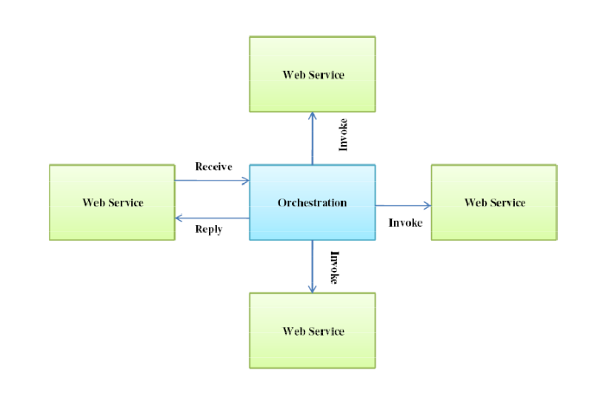
5. SoS collaboration driven by policies
Objective:
SoS collaboration driven by policies
Approach:
Policy conducted microservice workflow execution
LTU expertise and background:
Microservice SoS execution in industrial context since 2004
Professor Jerker Delsing
Colaborative digital twins

Slide 63
5. AI for autonomous self-integrating SoS
Objective:
Adaptive SoS in industry
Approach:
Adaptive SoS enabled by swarm intelligence and interoperability
Self-integration and reconfiguration achieved by intelligent agents with reasoning capabilities
LTU expertise and background:
Use-case of automating factory and energy processes using multi-agent architectures exhibiting emergent swarm intelligence
Professor Valeriy Vyatkin, Dr Sandeep Patil, Dr Chen-Wei Yang
Self-organising SoS
Collectively leraning and reasoning machines
Ubiquitous fully autonomous SoS

Slide 64
5. Secure data exchange in federated SoS
Objective:
Scalable and secure sharing of data in partner eco-systems, supported by dynamically adaptable authorization and usage control, traceability and access revocation
Approach:
Attribute-based access control (and encryption) combined with block-chained inspired methods to automate contractual interactions for agreements on data sharing, enabled by both pub-sub and request-response massaging patterns
LTU expertise and background:
Research on contractual interactions since 2017
Research on attribute-based access control since 2019
Professor Ulf Bodin, Professor Olov Schelén
Enhanced network platform features & services
Digital infrastructure for the programmable world
E2E security assurance across the life cycle

Slide 65
5. Ubiquitous fully autonomous SoS:
Ubiquitous energy aware swarms
Objectives:
Autonomous integration of energy flexibility
Approach:
Semantic and ML driven digital integration of energy flexibility
Data-driven creation of digital twins and model-based decision making
Energy-awareness of autonomous peer to peer communicating actors in factories, edge datacenters, microgrids and their collaborative actions towards optimisation of efficiency
LTU expertise and background:
Distributed system design in energy systems since 2010
Prof. Valeriy Vyatkin, Dr Chen-Wei Yang
Self-organising SoS
Ubiquitous fully autonomous SoS
Digital twins & CPS everywhere
Colaborative digital twins
Interoperability
34

Slide 66
Wireless Swarm Intelligence at the factory floor
5. Ubiquitous fully autonomous SoS
Objective:
Combining truly distributed and autonomous control systems and its integration with AI to achieve swarm intelligence
Approach:
Use of wireless connectivity, multi-agent architecture, IEC 61499 standard, distributed control and its interoperability features to integrate AI into the distributed control
LTU background & competence:
20+ years of experience in the distributed systems paradigm
Experience delivering the Industry 4.0 Testbed to Daedalus and 1-SWARM H2020 projects
Professor Valeriy Vyatkin, Dr Sandeep Patil
Network as mediator for intelligent machines
Self-organising SoS
Collectively leraning and reasoning machines
Ubiquitous fully autonomous SoS
35

Slide 67
Thanks!
Looking forward to collaborate Ericsson – LTU!
Contact:
Michael Nilsson,Centre for Distance-spanning Technology at Luleå University of Technology
Michael.Nilsson@ltu.se, 0920-492306

